Slide 1
HARVESTIFY A CROP RECOMMENDATION AND FERTILIZER SUGGESTION WEBSITE
BY
PAUL DAKKUMALLA(U00869370)
RAKESH SADULA(U00872618)
YASHWANTEJ DYAVARI SHETTY(U00874238)

Slide 2
Contents
Introduction
Problem Statement
State-of-the-art
Methodology
Accuracy
Implementation
Conclusion & Future work
References

Slide 3
Introduction
The project “HARVESTIFY” is aimed at developing a website that recommends the best crop to grow and fertilizers to use for your crops.
In the crop recommendation website, the user can provide the soil data from their side and the website will predict which crop should the user grow.
For the fertilizer recommendation website, the user can input the soil data and the type of crop they are growing, and the website will predict what the soil lacks or has an excess of and will recommend improvements.

Slide 4
Problem Statement
The reverse labor migration led to scarcity of labor which affected harvesting.
Many farmers are unaware and grow crops which are unsuitable on a particular land which lead to a huge loss of time and equipment.
Therefore, in order to solve this problem, farmers can take help from this website to know the most suitable crop to grow on their land.
In addition, they can also know which fertilizer to use on the crop to get good results.

Slide 5
Methodology
The website has been developed using:
HTML
CSS
Javascript
Flask
The model was built using the algorithms listed below :
Decision Tree
Gaussian Naive Bayes
Support vector Machine
Logistic Regression
Random Forest
XGBoost

Slide 6
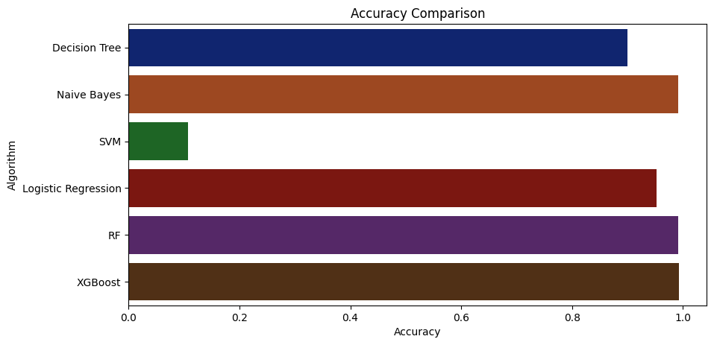
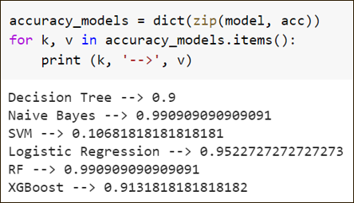
Accuracy
Performance

Slide 7
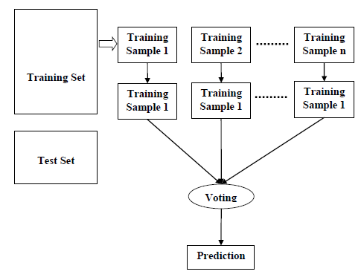
Random forest

Slide 8
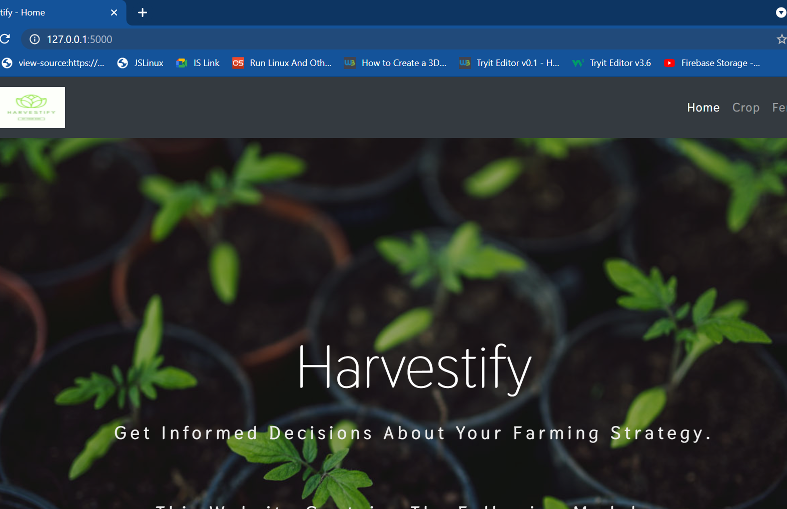
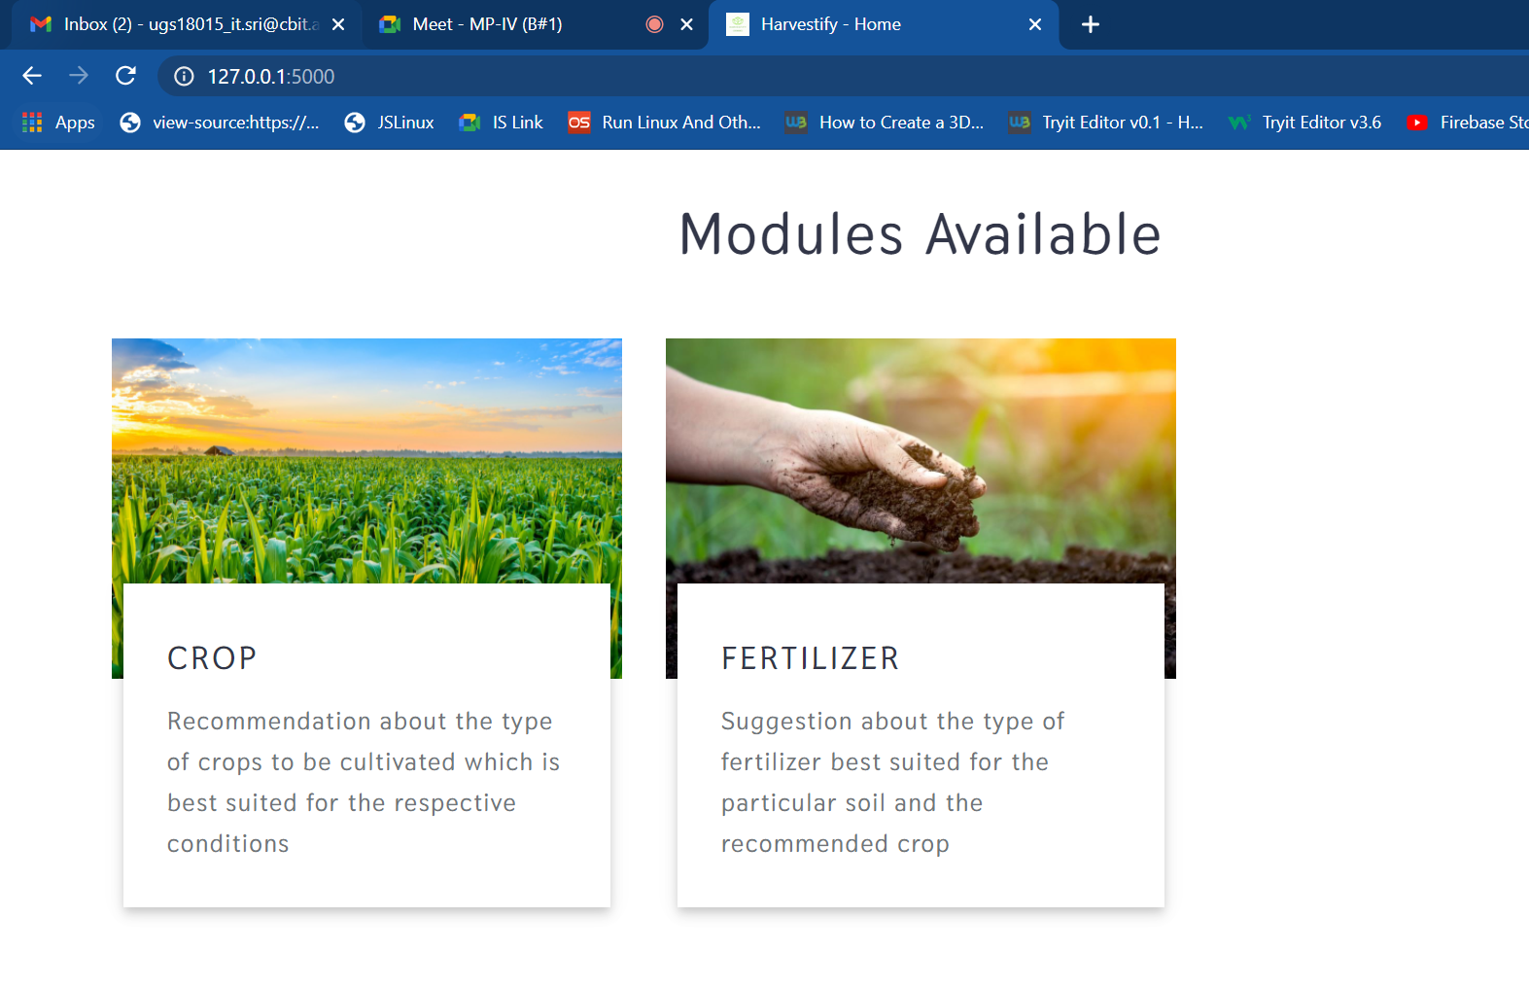
IMPLEMENTION
Home page

Slide 9
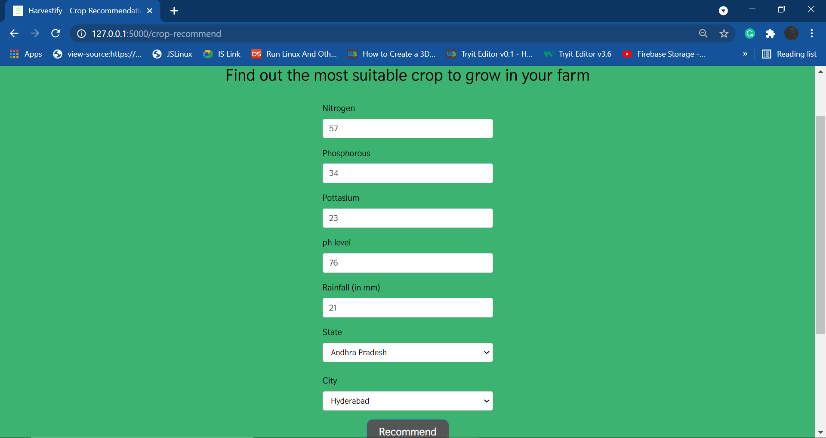
Crop recommendation page

Slide 10
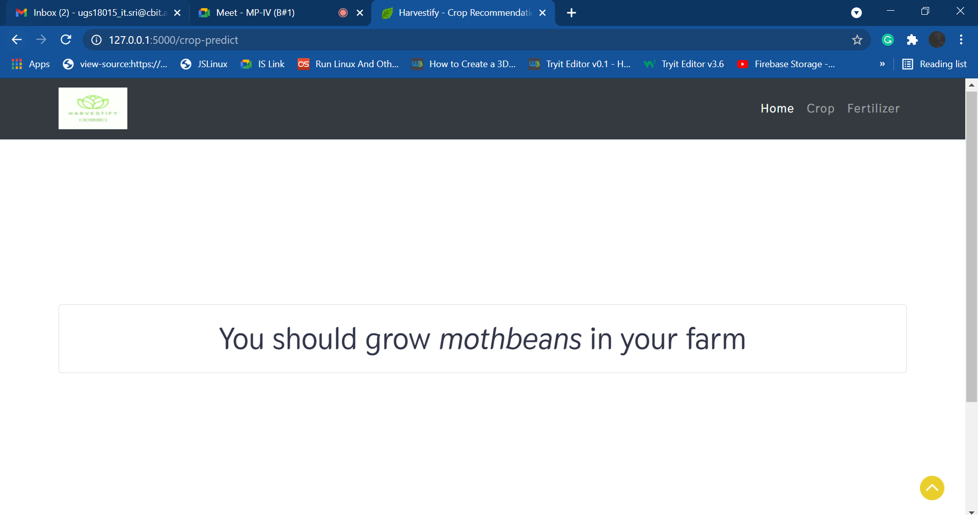
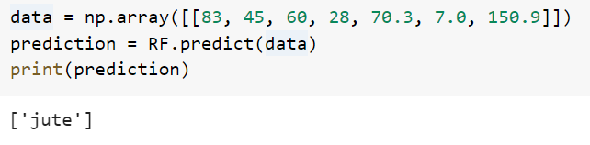
Crop recommendation Result

Slide 11
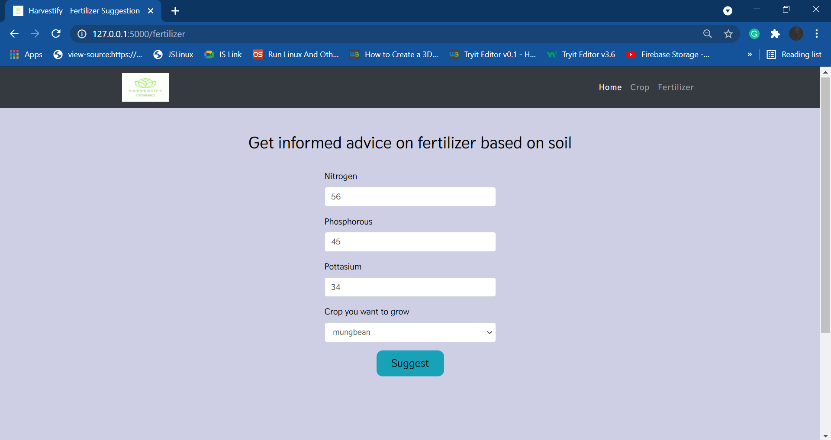
Recommendation Page

Slide 12
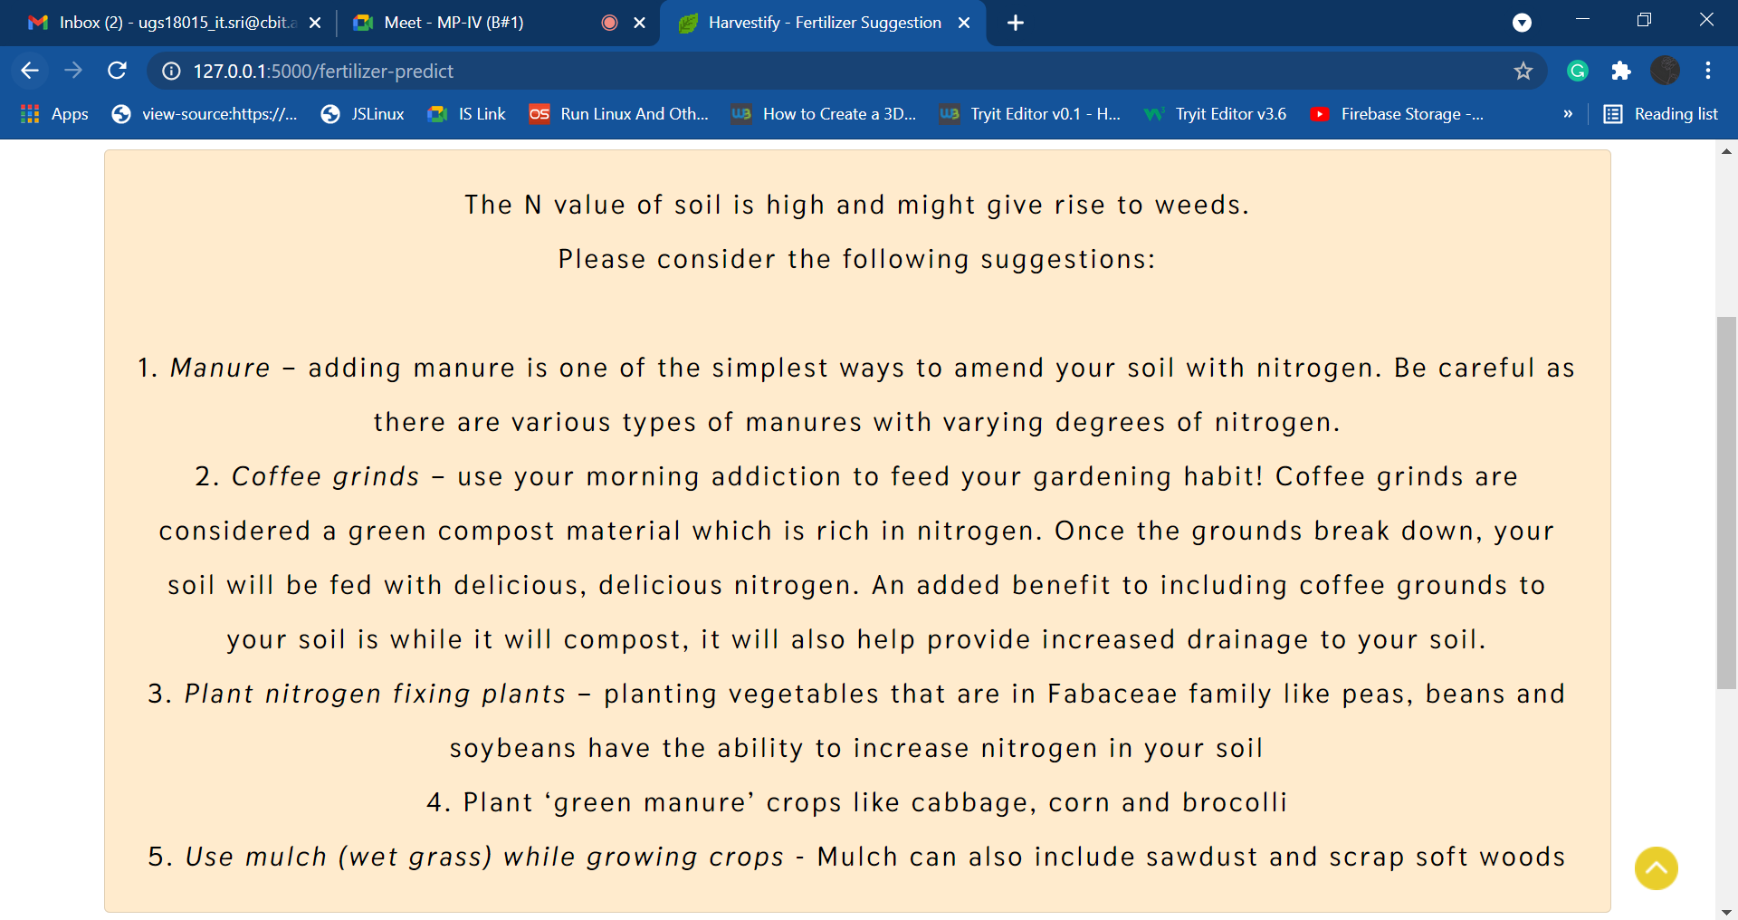
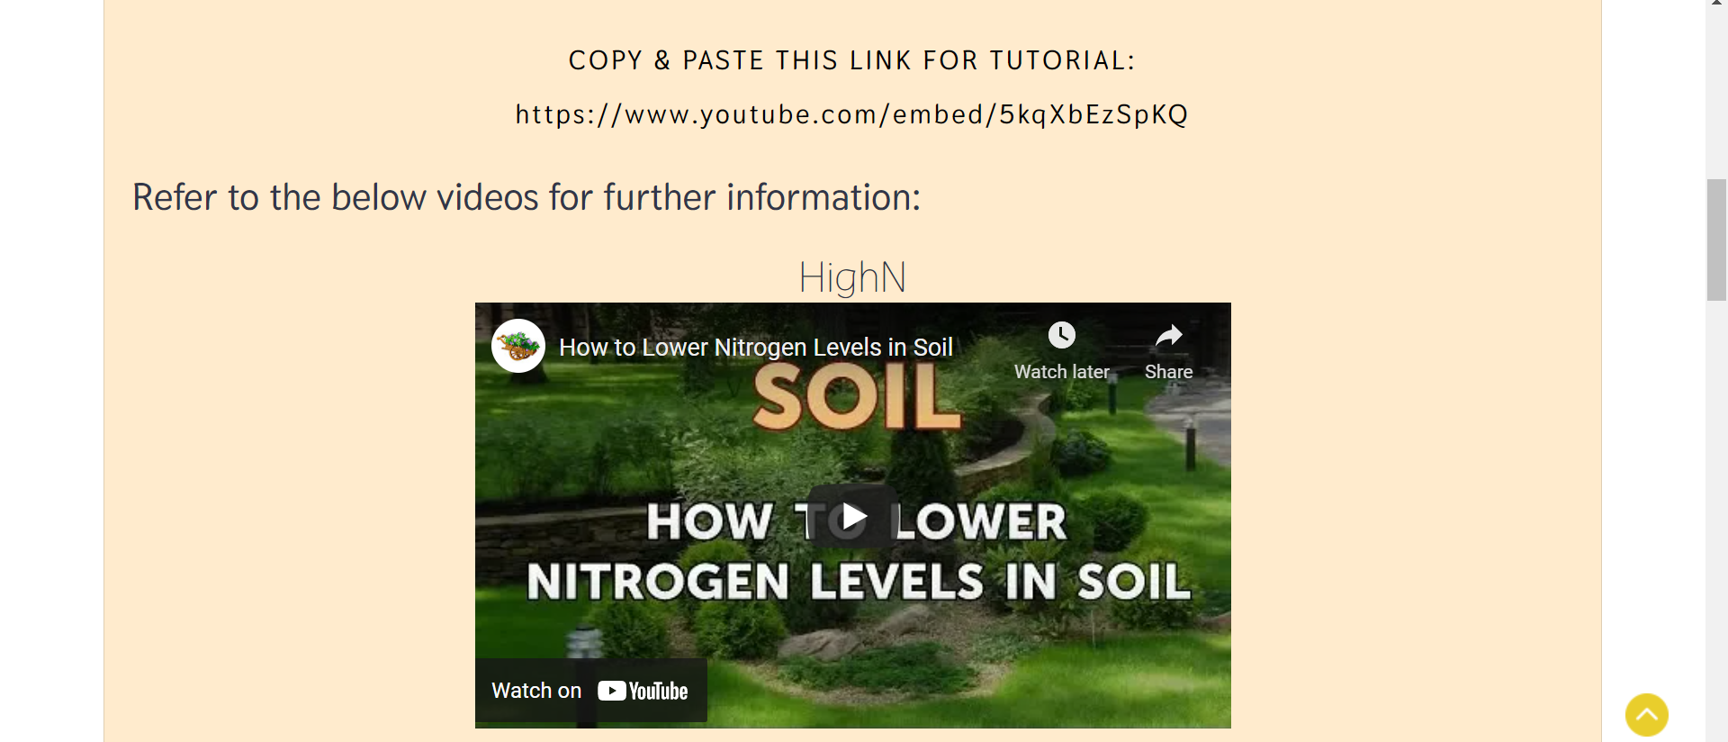
Fertilizer recommendation Result

Slide 13
Conclusion & Future work
Conclusion:
The website is developed in such a way that farmers can get crop recommendation w.r.t real-time weather data.
The website is user-friendly.
Future Work:
A mobile website can be made.
Improve the range of cities included.
Multi Language support

Slide 14
References
https://docplayer.net/102704394-Survey-of-crop-recommendation-systems.html
https://www.researchgate.net/publication/317696446_Crop_recommendation_system_for_precision_agriculture
http://sersc.org/journals/index.php/IJAST/article/download/7794/4513/
http://www.sersc.org/journals/index.php/IJFGCN/article/download/28584/15900/
https://www.ijrte.org/wp-content/uploads/papers/v7i5c/E10300275C19.pdf

Slide 15
Thank You

